Slide 1
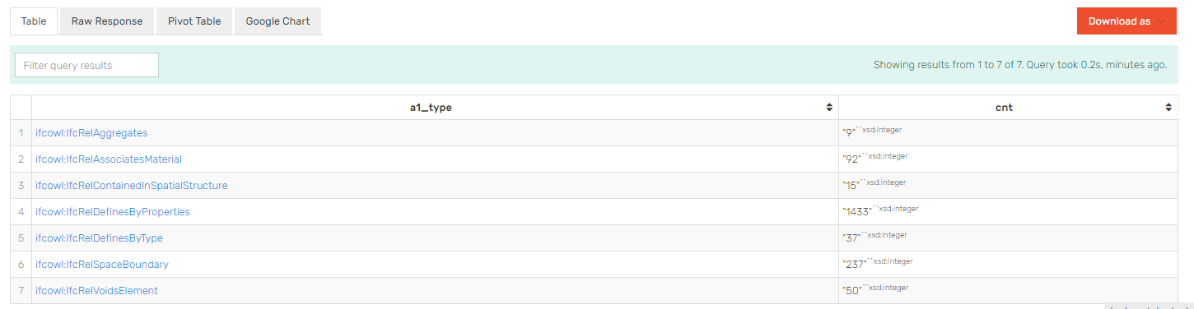
select ?a1_type (count(distinct ?a1) as ?cnt)
WHERE {
?a1 ?p1 ?a .
?a1 ?p2 ?b .
?a a ?a_type .
?b a ?b_type .
?a1 a ?a1_type .
FILTER (regex(str(?a1_type),"IfcRel"))
FILTER (regex(str(?p1),"IfcRel"))
FILTER (regex(str(?p2),"IfcRel"))
FILTER (?a != ?b)
FILTER (?p1 != ?p2)
} GROUP BY ?a1_type ORDER BY ?a1_type
NBU Duplex Arch Queries

Slide 2
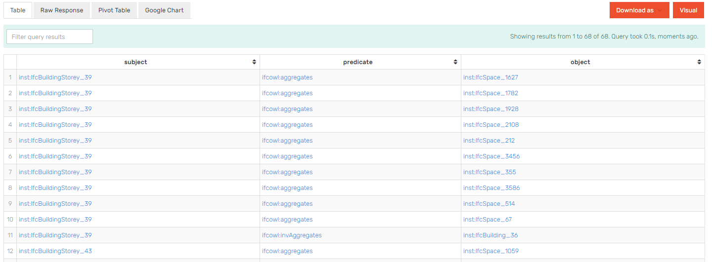
PREFIX ifcowl: <http://www.buildingsmart-tech.org/ifcOWL/IFC2X3_TC1#>
CONSTRUCT {?a ?rel ?b. ?b ?inverseRel ?a }
WHERE {
?a1 ?p1 ?a .
?a1 ?p2 ?b .
?a a ?a_type .
?b a ?b_type .
?a1 a ?a1_type .
FILTER (regex(str(?p1),"IfcRel"))
FILTER (regex(str(?p1),"relating"))
FILTER (regex(str(?p2),"IfcRel"))
FILTER (regex(str(?p2),"related"))
FILTER (?a != ?b)
FILTER (?p1 != ?p2)
Values ?a1_type { ifcowl:IfcRelAggregates }.
BIND(STRAFTER(str(?a1_type),"IFC2X3_TC1#") as ?localName) .
BIND(REPLACE(?localName,"IfcRel","") as ?localName1) .
BIND(CONCAT(LCASE(SUBSTR(?localName1,1,1)),SUBSTR(?localName1,2,STRLEN(?localName1)-1)) as ?localName2) .
BIND(IRI(CONCAT("http://www.buildingsmart-tech.org/ifcOWL/IFC2X3_TC1#","inv",?localName1)) as ?inverseRel) .
BIND(IRI(CONCAT("http://www.buildingsmart-tech.org/ifcOWL/IFC2X3_TC1#",?localName2)) as ?rel) .
} ORDER BY ?rel

Slide 3
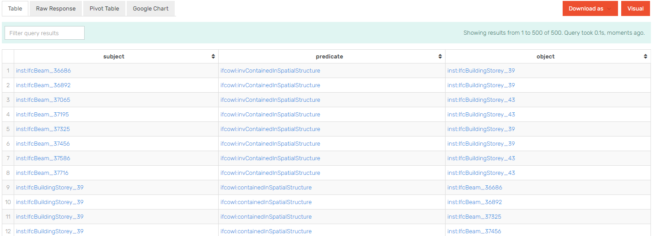
PREFIX ifcowl: <http://www.buildingsmart-tech.org/ifcOWL/IFC2X3_TC1#>
CONSTRUCT {?a ?rel ?b. ?b ?inverseRel ?a }
WHERE {
?a1 ?p1 ?a .
?a1 ?p2 ?b .
?a a ?a_type .
?b a ?b_type .
?a1 a ?a1_type .
FILTER (regex(str(?p1),"IfcRel"))
FILTER (regex(str(?p1),"relating"))
FILTER (regex(str(?p2),"fcRel"))
FILTER (regex(str(?p2),"related"))
FILTER (?a != ?b)
FILTER (?p1 != ?p2)
Values ?a1_type { ifcowl:IfcRelContainedInSpatialStructure ifcowl:IfcRelVoidsElement }.
BIND(STRAFTER(str(?a1_type),"IFC2X3_TC1#") as ?localName).
BIND(REPLACE(?localName,"IfcRel","") as ?localName1) .
BIND(CONCAT(LCASE(SUBSTR(?localName1,1,1)),SUBSTR(?localName1,2,STRLEN(?localName1)-1)) as ?localName2) .
BIND(IRI(CONCAT("http://www.buildingsmart-tech.org/ifcOWL/IFC2X3_TC1#","inv",?localName1)) as ?inverseRel) .
BIND(IRI(CONCAT("http://www.buildingsmart-tech.org/ifcOWL/IFC2X3_TC1#",?localName2)) as ?rel) .
} ORDER BY ?rel #OFFSET 5000

Slide 4
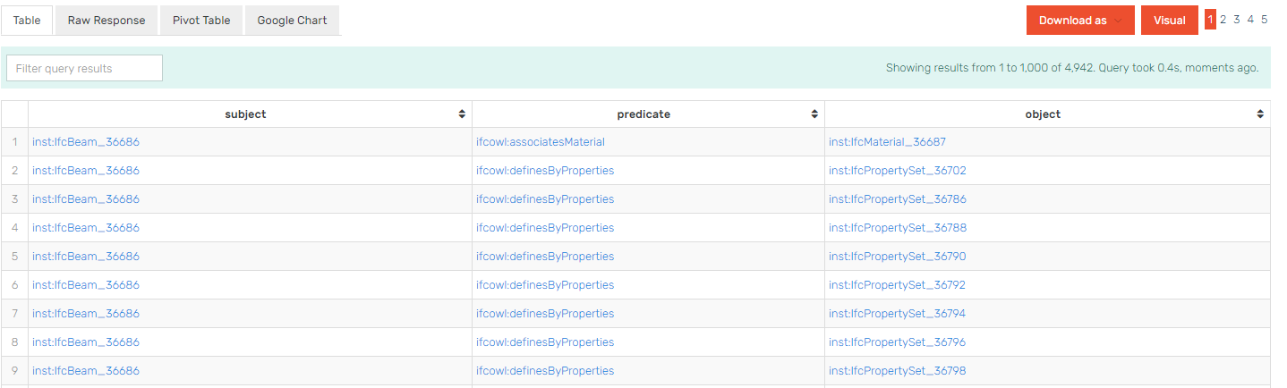
PREFIX ifcowl: <http://www.buildingsmart-tech.org/ifcOWL/IFC2X3_TC1#>
CONSTRUCT {?a ?rel ?b. ?b ?inverseRel ?a }
WHERE {
?a1 ?p1 ?a .
?a1 ?p2 ?b .
?a a ?a_type .
?b a ?b_type .
?a1 a ?a1_type .
FILTER (regex(str(?p1),"IfcRel"))
FILTER (regex(str(?p1),"related"))
FILTER (regex(str(?p2),"IfcRel"))
FILTER (regex(str(?p2),"relating"))
FILTER (?a != ?b)
FILTER (?p1 != ?p2)
Values ?a1_type { ifcowl:IfcRelAssociatesMaterial ifcowl:IfcRelDefinesByType ifcowl:IfcRelDefinesByProperties }.
BIND(STRAFTER(str(?a1_type),"IFC2X3_TC1#") as ?localName) .
BIND(REPLACE(?localName,"IfcRel","") as ?localName1).
BIND(CONCAT(LCASE(SUBSTR(?localName1,1,1)),SUBSTR(?localName1,2,STRLEN(?localName1)-1)) as ?localName2).
BIND(IRI(CONCAT("http://www.buildingsmart-tech.org/ifcOWL/IFC2X3_TC1#","inv",?localName1)) as ?inverseRel) .
BIND(IRI(CONCAT("http://www.buildingsmart-tech.org/ifcOWL/IFC2X3_TC1#",?localName2)) as ?rel) .
} ORDER BY ?rel #OFFSET 5000

Slide 5
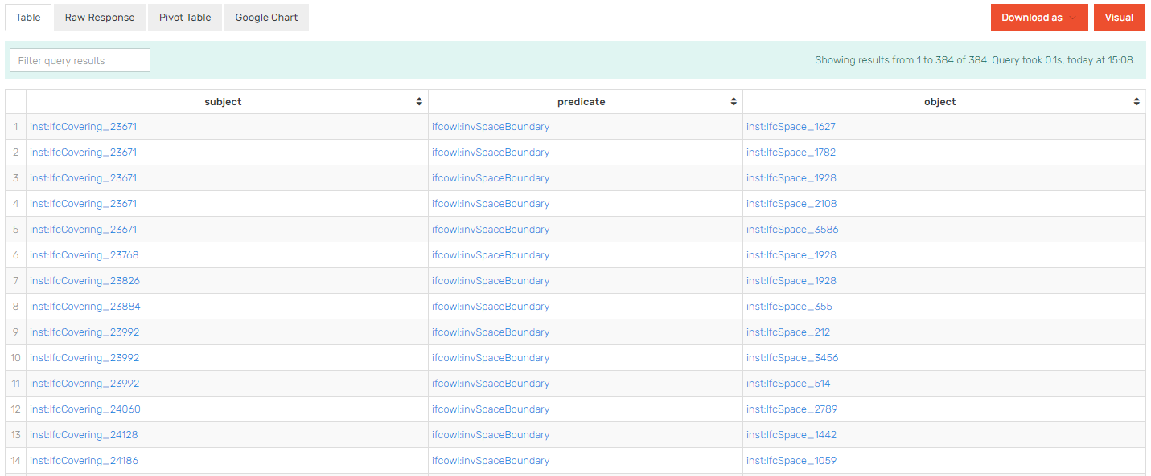
PREFIX ifcowl: <http://www.buildingsmart-tech.org/ifcOWL/IFC2X3_TC1#>
CONSTRUCT {?a ?rel ?b. ?b ?inverseRel ?a }
WHERE {
?a1 ?p1 ?a .
?a1 ?p2 ?b .
?a a ?a_type .
?b a ?b_type .
?a1 a ?a1_type .
FILTER (regex(str(?p1),"IfcRel"))
FILTER (regex(str(?p1),"relating"))
FILTER (regex(str(?p2),"IfcRel"))
FILTER (regex(str(?p2),"related"))
FILTER (?a != ?b)
FILTER (?p1 != ?p2)
Values ?a1_type { ifcowl:IfcRelSpaceBoundary }.
BIND(STRAFTER(str(?a1_type),"IFC2X3_TC1#") as ?localName) .
BIND(REPLACE(?localName,"IfcRel","") as ?localName1) .
BIND(CONCAT(LCASE(SUBSTR(?localName1,1,1)),SUBSTR(?localName1,2,STRLEN(?localName1)-1)) as ?localName2) .
BIND(IRI(CONCAT("http://www.buildingsmart-tech.org/ifcOWL/IFC2X3_TC1#","inv",?localName1)) as ?inverseRel) .
BIND(IRI(CONCAT("http://www.buildingsmart-tech.org/ifcOWL/IFC2X3_TC1#",?localName2)) as ?rel) .
} ORDER BY ?rel

Slide 6
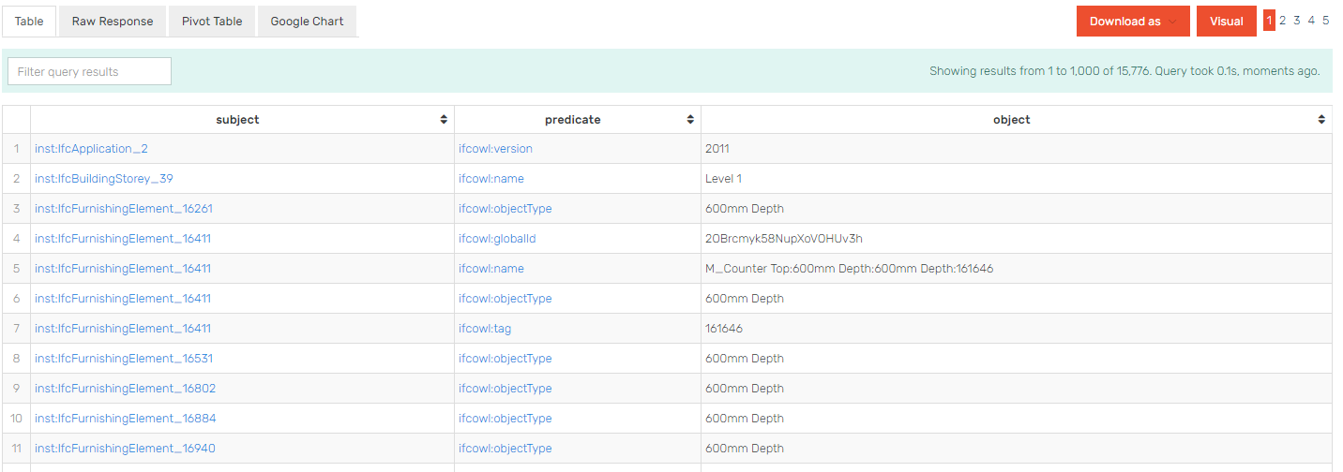
PREFIX ifcowl: <http://www.buildingsmart-tech.org/ifcOWL/IFC2X3_TC1#>
PREFIX rdf: <http://www.w3.org/1999/02/22-rdf-syntax-ns#>
PREFIX express: <https://w3id.org/express#>
PREFIX inst: <http://linkedbuildingdata.net/ifc/resources5de8bd1e/>
Construct {?s ?rel ?y.}
where {
?s ?t ?x.
?x express:hasString ?y.
BIND(STRAFTER(str(?t),"IFC2X3_TC1#") as ?localName) .
BIND(STRBefore(str(?localName),"_") as ?localName2).
BIND(IRI(CONCAT("http://www.buildingsmart-tech.org/ifcOWL/IFC2X3_TC1#",?localName2)) as ?rel) .
}

Slide 7
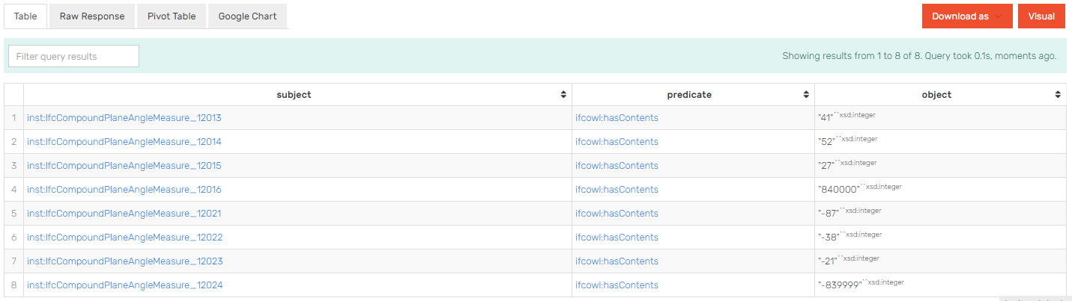
PREFIX ifcowl: <http://www.buildingsmart-tech.org/ifcOWL/IFC2X3_TC1#>
PREFIX rdf: <http://www.w3.org/1999/02/22-rdf-syntax-ns#>
PREFIX express: <https://w3id.org/express#>
PREFIX inst: <http://linkedbuildingdata.net/ifc/resources5de8bd1e/>
Construct {?s ?rel ?y.}
where {
?s ?t ?x.
?x express:hasInteger ?y.
BIND(STRAFTER(str(?t),"list#") as ?localName).
BIND(IRI(CONCAT("http://www.buildingsmart-tech.org/ifcOWL/IFC2X3_TC1#",?localName)) as ?rel) .
filter(regex(str(?rel), "hasContents")).
}

Slide 8
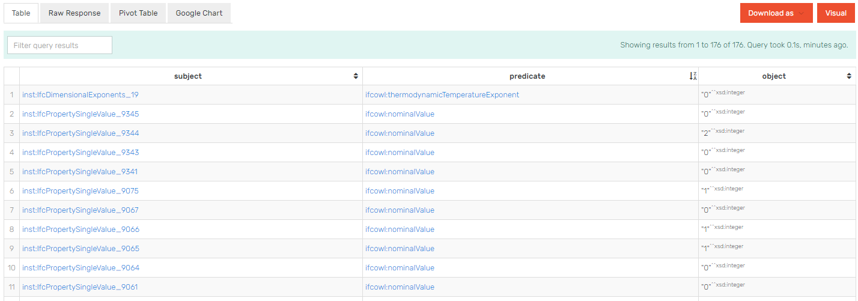
PREFIX ifcowl: <http://www.buildingsmart-tech.org/ifcOWL/IFC2X3_TC1#>
PREFIX rdf: <http://www.w3.org/1999/02/22-rdf-syntax-ns#>
PREFIX express: <https://w3id.org/express#>
PREFIX inst: <http://linkedbuildingdata.net/ifc/resources5de8bd1e/>
Construct {?s ?rel ?y.}
where {
?s ?t ?x.
?x express:hasInteger ?y.
BIND(STRAFTER(str(?t),"IFC2X3_TC1#") as ?localName) .
BIND(STRBefore(str(?localName),"_") as ?localName2).
BIND(IRI(CONCAT("http://www.buildingsmart-tech.org/ifcOWL/IFC2X3_TC1#",?localName2)) as ?rel) .
}

Slide 9
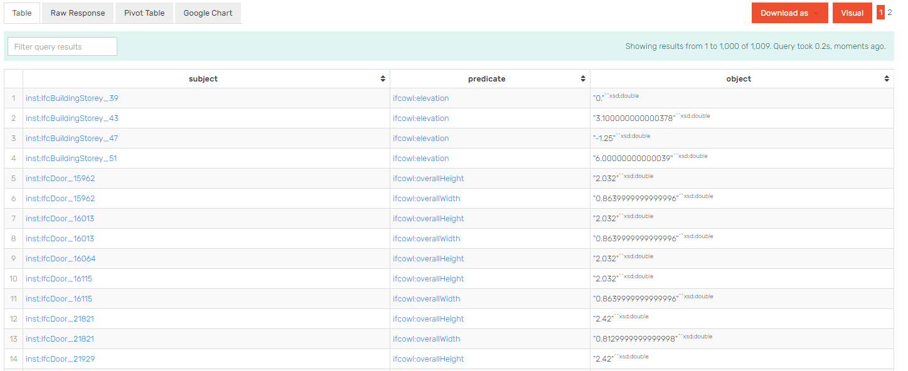
PREFIX ifcowl: <http://www.buildingsmart-tech.org/ifcOWL/IFC2X3_TC1#>
PREFIX rdf: <http://www.w3.org/1999/02/22-rdf-syntax-ns#>
PREFIX express: <https://w3id.org/express#>
PREFIX inst: <http://linkedbuildingdata.net/ifc/resources5de8bd1e/>
Construct {?s ?rel ?y.}
where {
?s ?t ?x.
?x express:hasDouble ?y.
BIND(STRAFTER(str(?t),"IFC2X3_TC1#") as ?localName) .
BIND(STRBefore(str(?localName),"_") as ?localName2).
BIND(IRI(CONCAT("http://www.buildingsmart-tech.org/ifcOWL/IFC2X3_TC1#",?localName2)) as ?rel) .
}

Slide 10
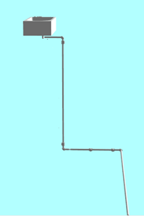
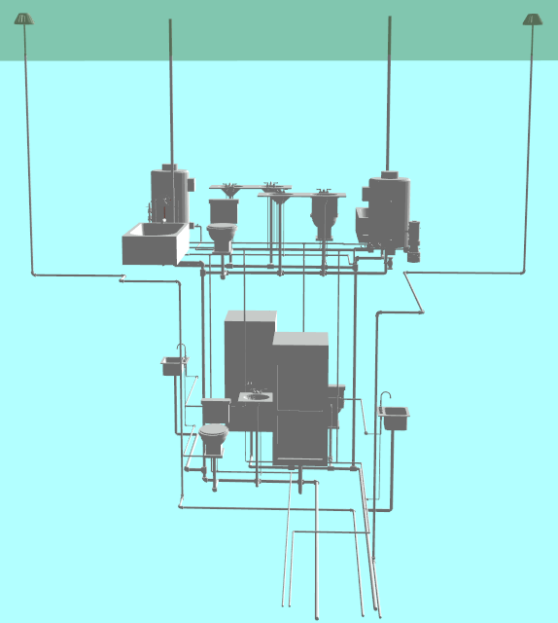
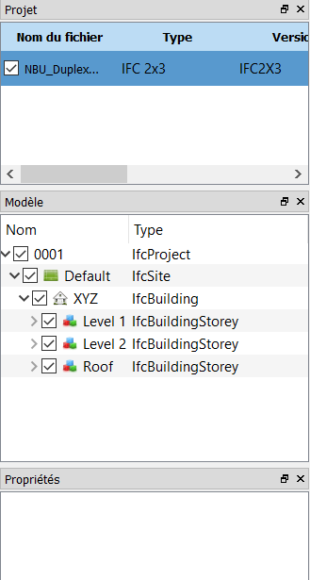
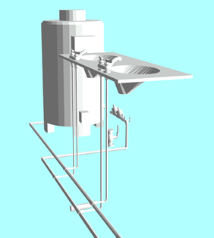
IfcFlowTerminal
IfcFlowSegment
Pipe types: Eau Usée
IfcFlowFitting
Exemple de la canalisation d’eau usée
IfcEnergyConversionDevice
Exemple de la canalisation d’eau potable froid et chaude
IfcFlowController
IfcFlowSegment
Pipe types: Eau Chaude
Pipe types: Eau Froid
IfcFlowFitting

